Slide 1
scRNA-Seq @ H3
2021.09.20 – Nathan T. Johnson

Slide 2
Outline
Actively evaluating scRNA-Seq capabilities @ H3
Key Areas of Consideration:
Wet Lab Logistics
Analysis Pipeline
Internal & Publicly Available Data
SBG Platform
External to SBG Platform
Storage & Data Access
Presentation
Rapid scRNA-Seq Background
H3 scRNA-Seq Analysis
Pilot Project Initiated & Analysis Evaluation

Slide 3
scRNA-Seq Rapid Background

Slide 4
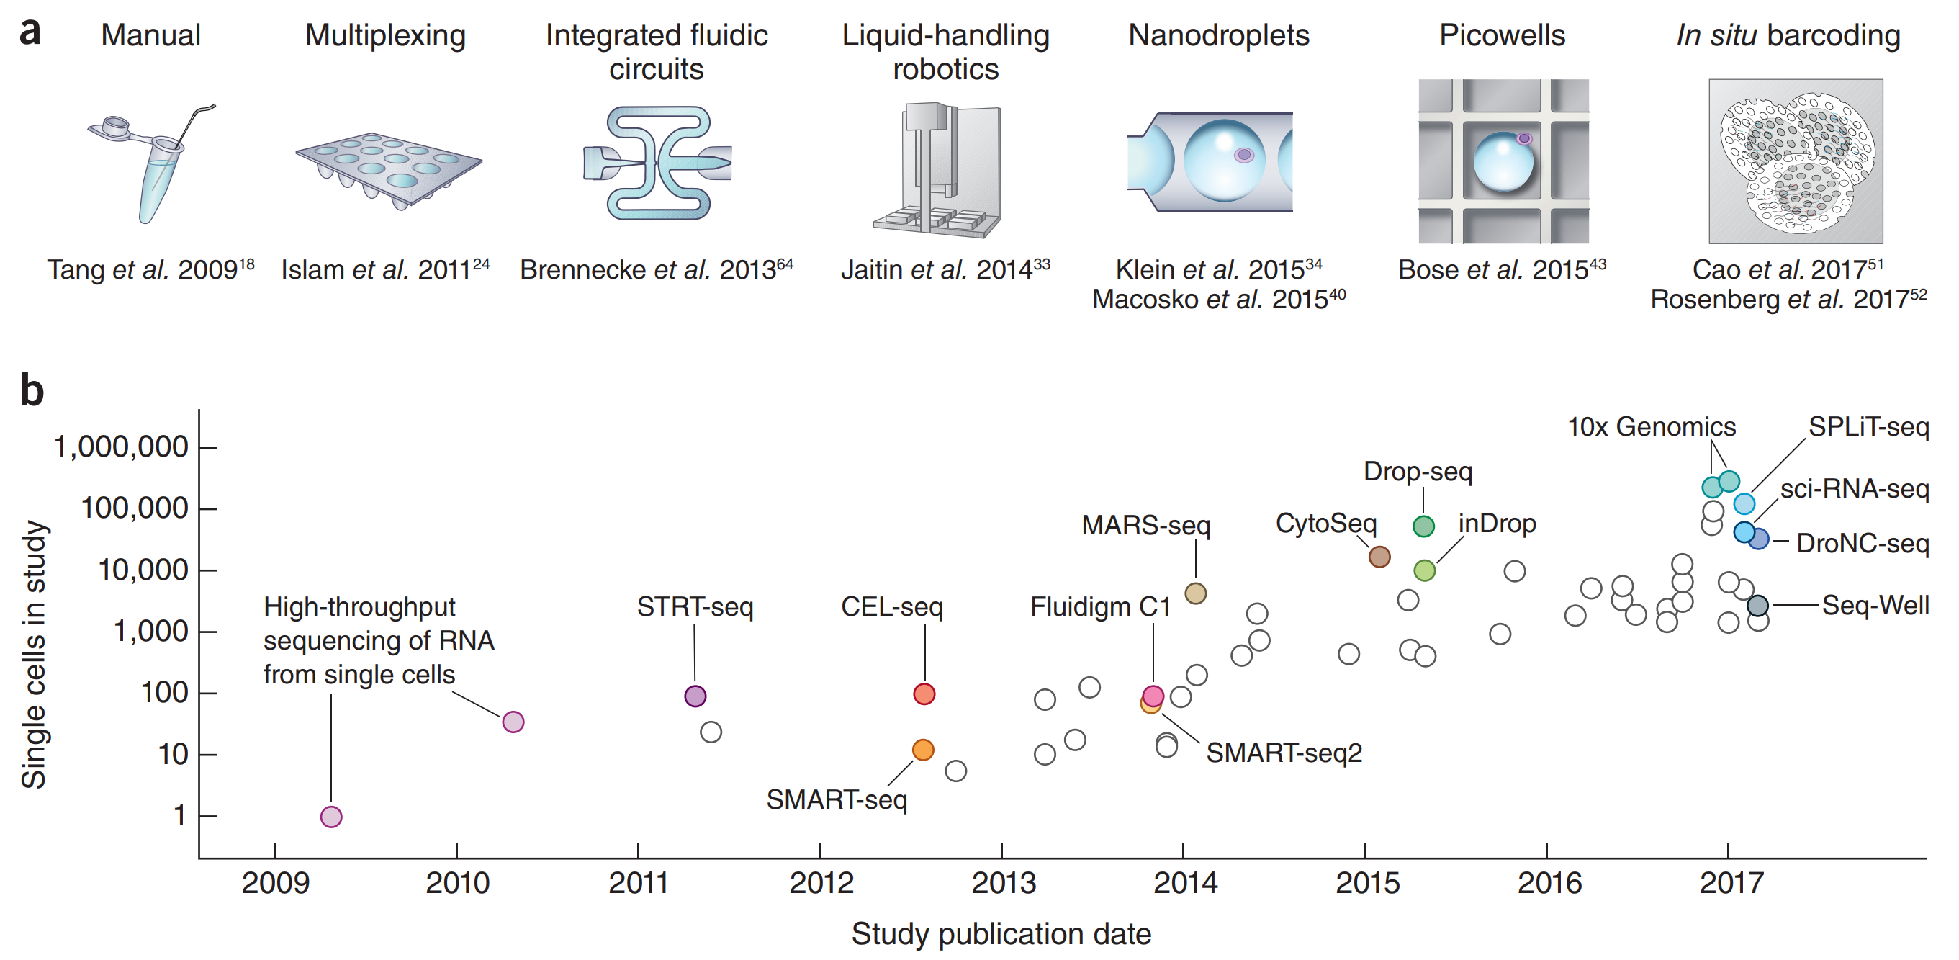
Overview of scRNA-Seq Technologies
Svensson et al 2018 https://doi.org/10.1038/nprot.2017.149

Slide 5
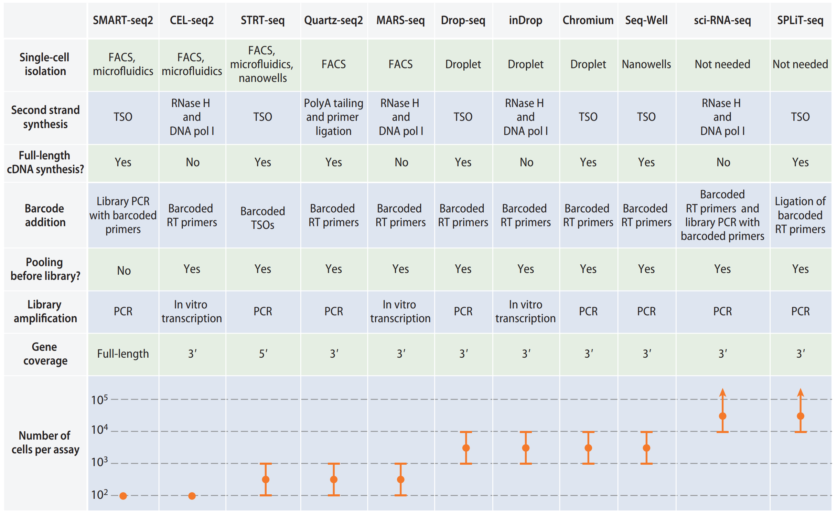
Overview of scRNA-Seq Library Preparation
Chromium = 10x Genomics
TSO = a template-switching oligonucleotide
Chen et al. 2018. DOI:10.1146/annurev-biodatasci-080917-013452

Slide 6
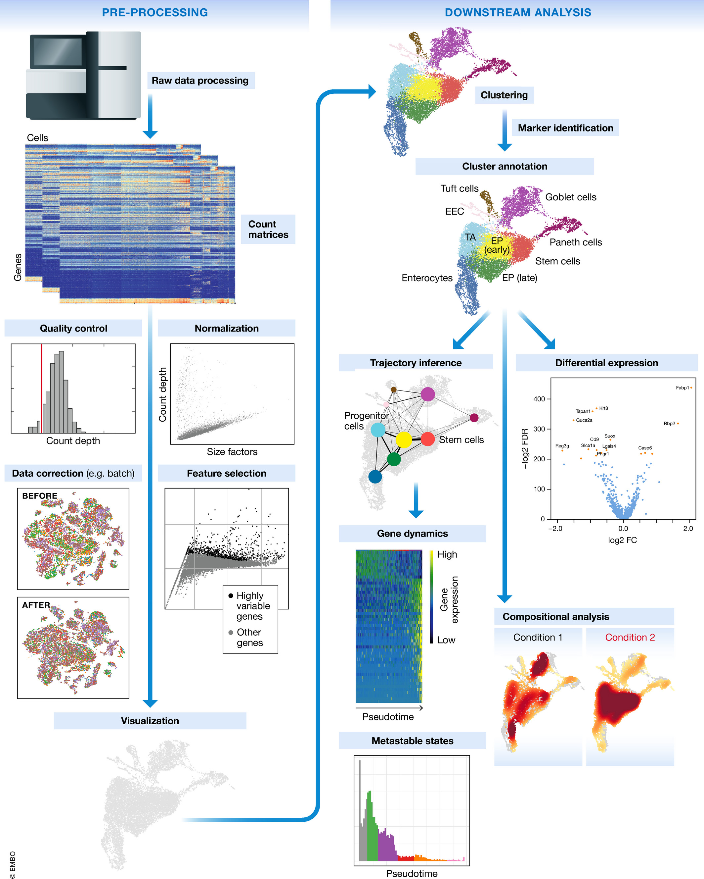
General scRNA-Seq Analysis
Quantify Expression
Preprocess (Quality Control)
Filter Cells
Empty Cells / Dead Cells / Doublet
# of UMI & Genes per Cell
Filter Genes with detection threshold
Remove Cells with high mitochondrial Content
Normalization (Not Standardized)
scTransform
Fits negative binomial generalized linear model for groups of genes with similar geometric means
Dimensionality Reduction
Clustering & Cell Annotation
Differential Analysis
Luecken, Malte D., and Fabian J. Theis. "Current best practices in single‐cell RNA‐seq analysis: a tutorial." Molecular systems biology 15.6 (2019): e8746.

Slide 7
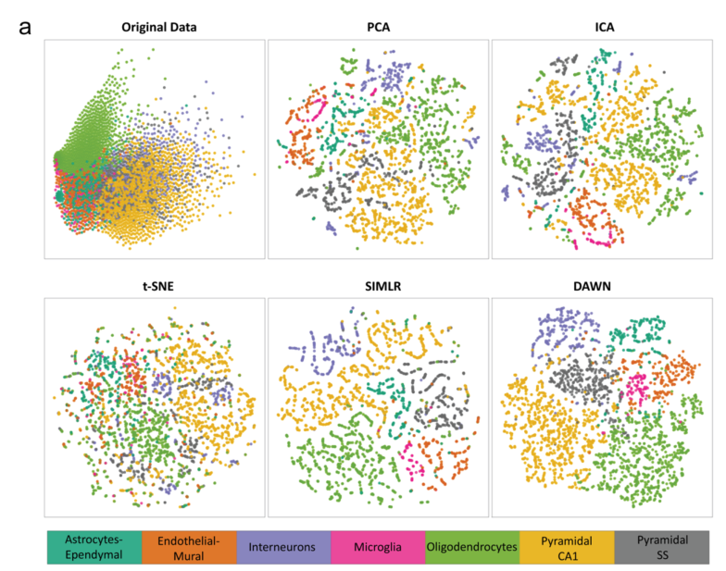
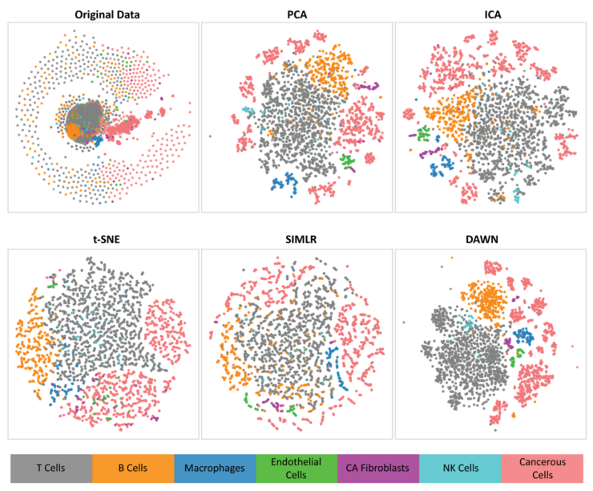
Feature Reduction Illustration
Srinivasan, S., Leshchyk, A., Johnson, N. T., & Korkin, D. (2020). A hybrid deep clustering approach for robust cell type profiling using single-cell RNA-seq data. RNA, 26(10), 1303-1319.

Slide 8
scRNA-Seq Analysis Pipeline

Slide 9
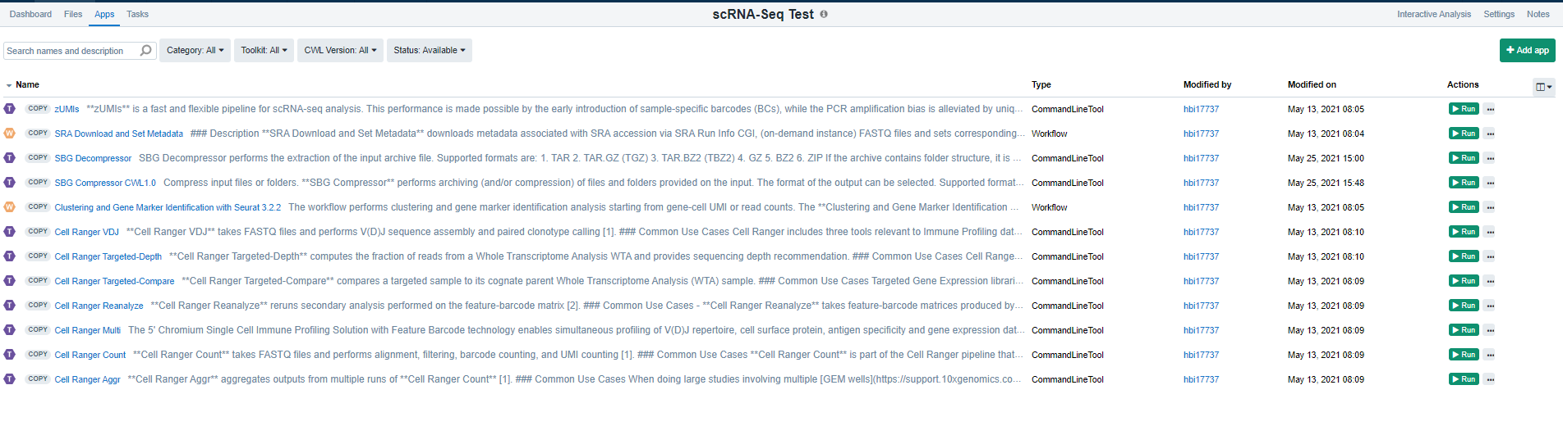
Current Useful SBG scRNA-Seq Apps
*Purple = single unconnected app **Orange = workflow that combines multiple single apps

Slide 10
Current scRNA-Seq SBG Workflow
Raw Sequencing Data
Publicly Available Raw Sequencing Data
SBG Apps
Apps to build
SRA Download and Extract
I/O
Compress Data
Apps Needing Editing
Reformat Files
Unused, but Available
Prepped Sequencing Data (fastq.gz)
Cell Ranger Targeted-Depth
Cell Ranger Count
Cell Ranger VDJ
Cell Ranger Aggregate
Cell Ranger Targeted Compare
Cell Ranger Reanalyze
Cluster & Gene Marker Analysis
Cell Ranger Multi*
*Combines the above

Slide 11
Current scRNA-Seq SBG Workflow Available Output
10x Cell Ranger has Limited Quality Control Assessment
UMI & Cell Overlap
Screening based on # of Genes detected
SBG Expanded Quality Control assessment
Raw & Filtered Matrix Count Data
Barcode/Feature/Gene based
Cluster Analysis (Expanded & Limited)
UMAP Dimensionality Reduction
K-means Cluster Analysis
Gene Biomarker for Cluster

Slide 12
Evaluation Goals
Identify relevant tools
Data Science Team
Biologists (interactive visualization)
Download multiple datasets
Publicly available
10x Human PMBC example dataset
Dataset mixture of mouse and human
Attempt to analyze datasets throughout entire pipeline
Primarily used
10x Cell Ranger
Visualization Tools
Bioturing (Paid, currently limited licenses)
Loupe (Free 10x Visualization Tool)

Slide 13
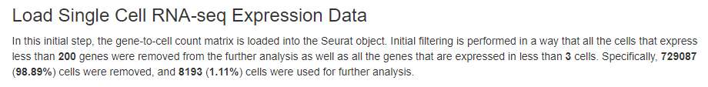
Quality Control Evaluation (Report)
Next few slides represent a pdf report for a scRNA-Seq analysis as possible deliverable for an H3 scRNA-Seq analysis
Report Start

Slide 14
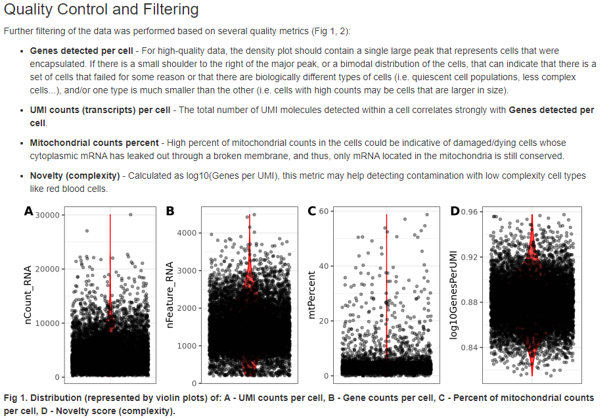
Quality Control and Filtering Part 1

Slide 15
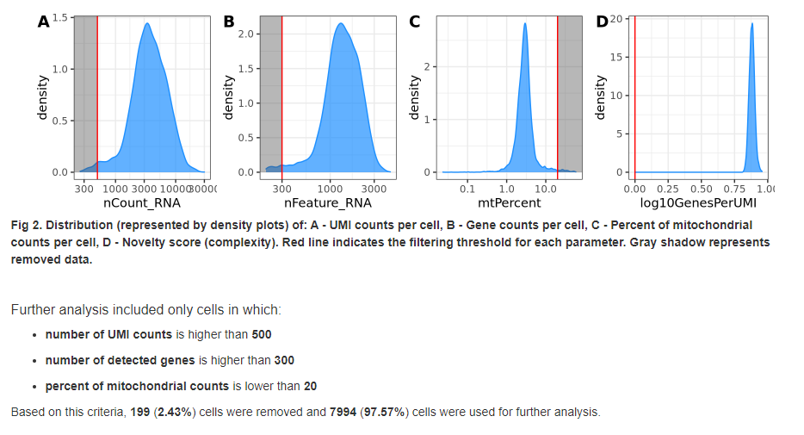
Quality Control and Filtering PT 2

Slide 16
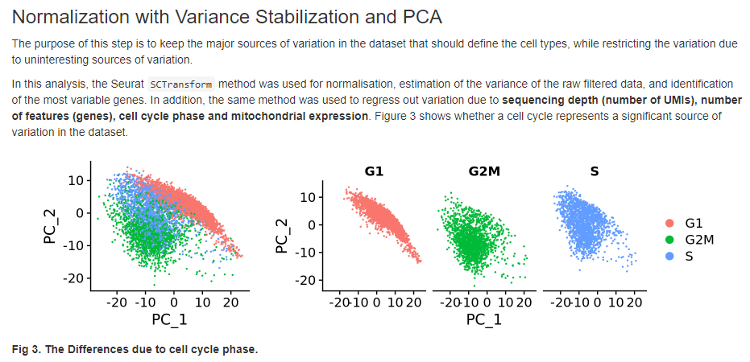
Analyzing Sources of Variation: Cell Cycle Phase

Slide 17
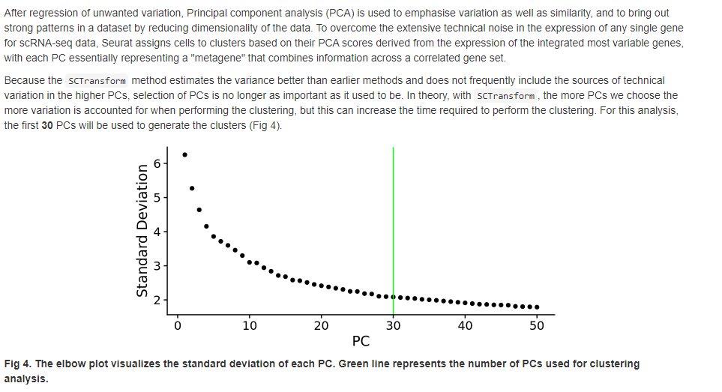
Balancing variation and similiarity

Slide 18
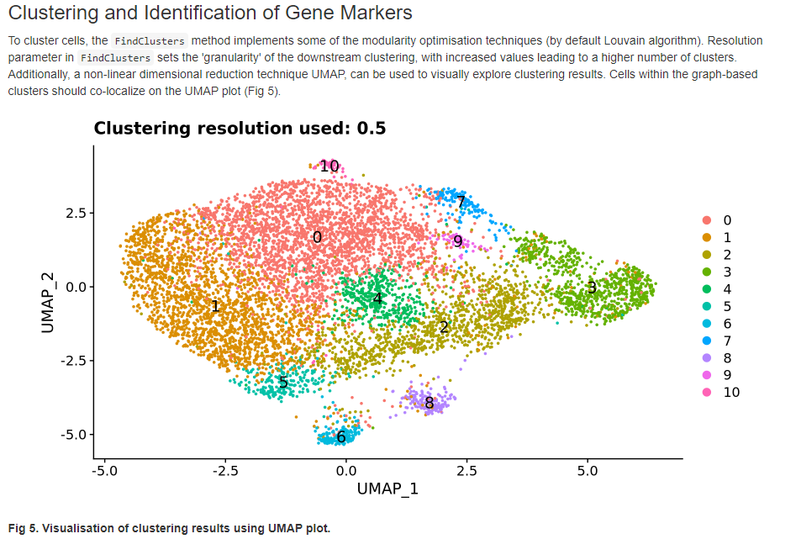
Identifying clusters and gene markers per cluster

Slide 19
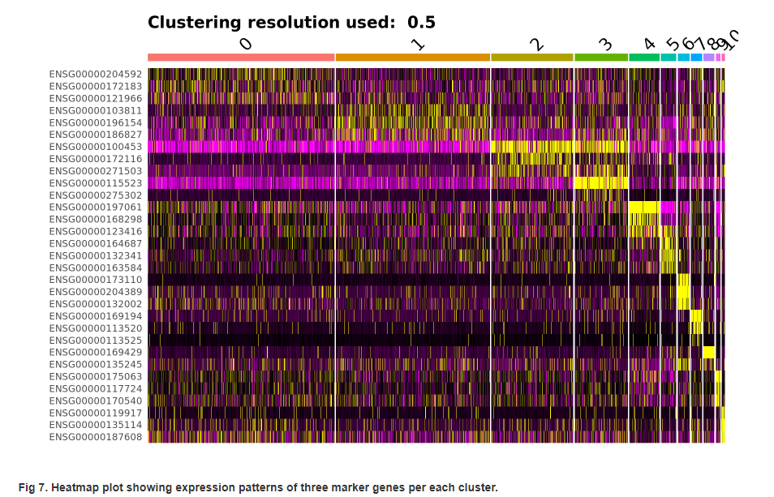
Heatmap Representations between different clusters

Slide 20
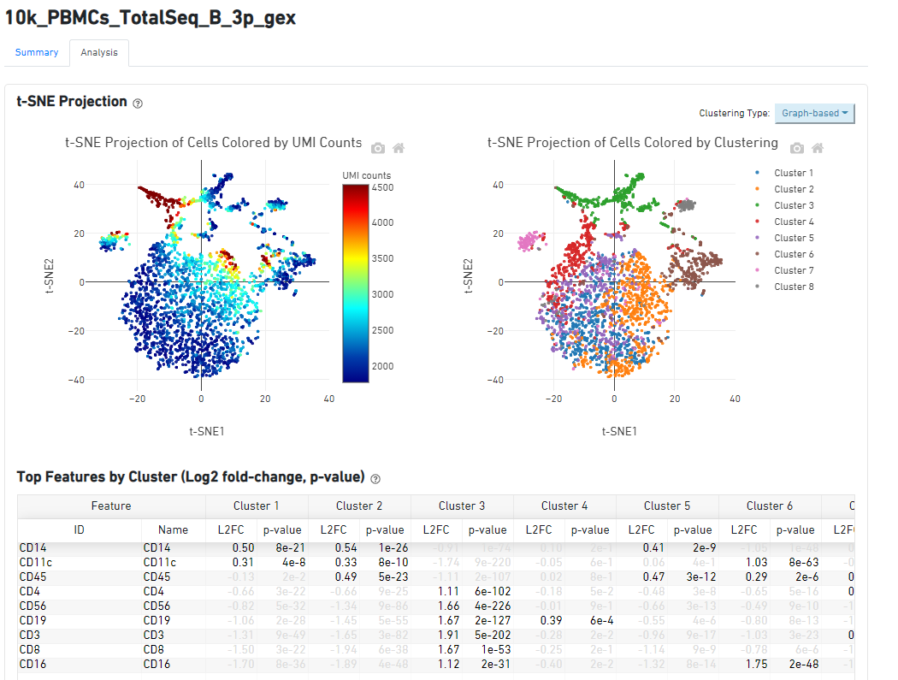
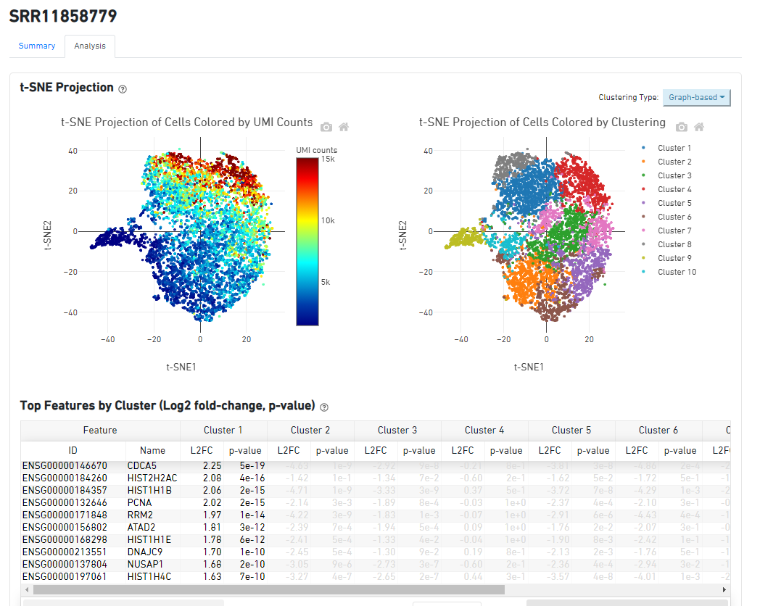
2 Dataset Examples from H3 Evaluation

Slide 21
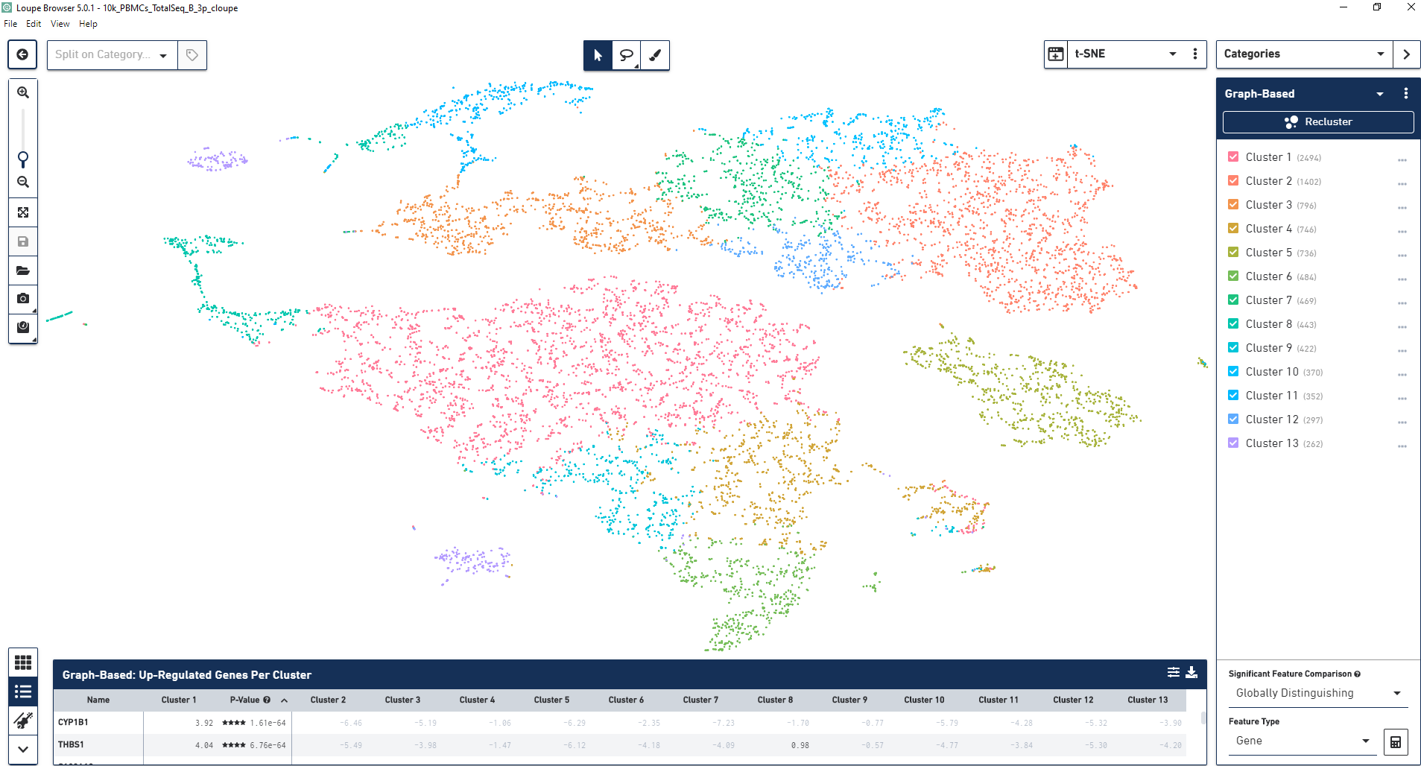
Example Loupe Interactive Visualization

Slide 22
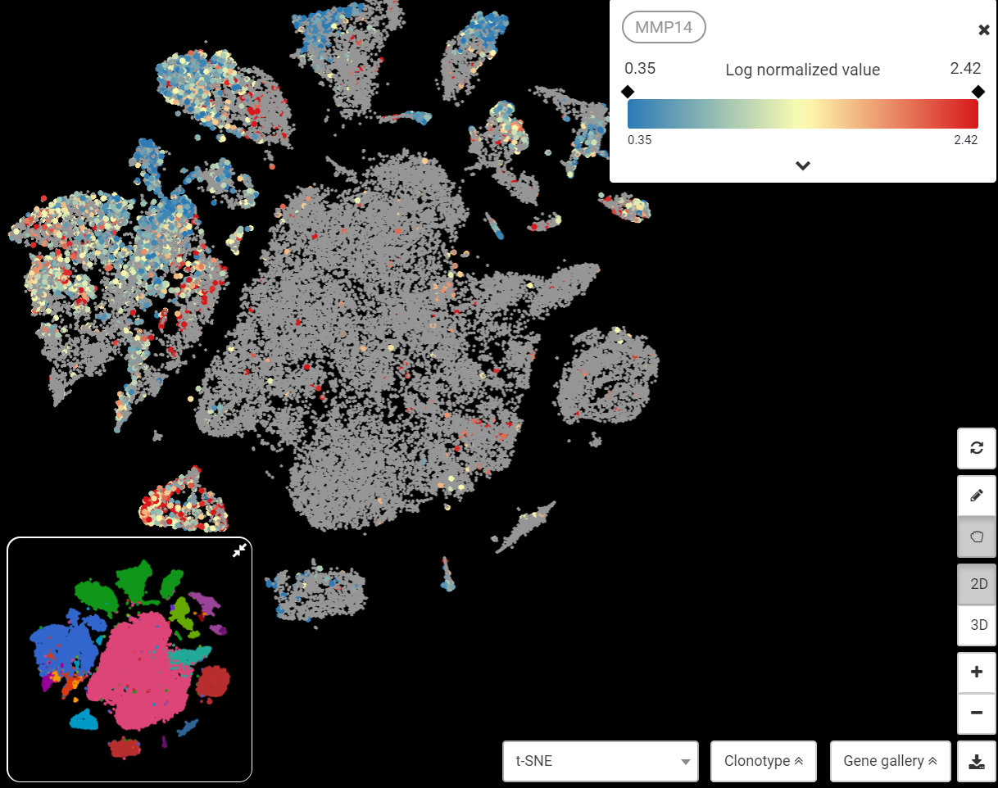
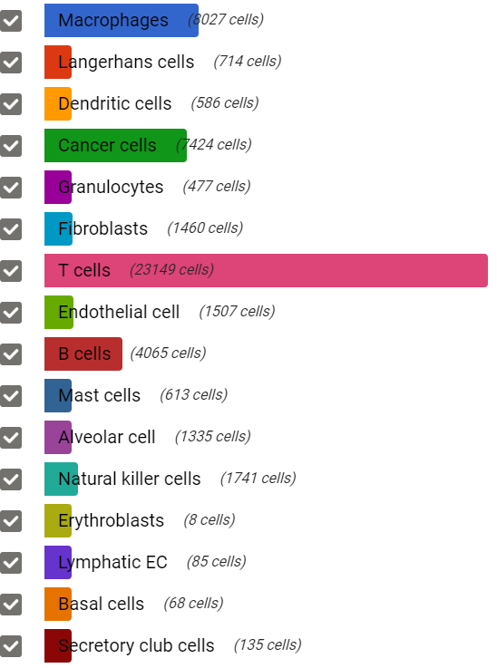
Example Bioturing Interactive Visualization
Cancer cells
Macrophage
Fibroblast
Bioturing
Head and Neck Cancer (GSE103322)

Slide 23
Possible scRNA-Seq Analysis Deliverables
Brainstorming on H3 Fully Desired Deliverables:
QC assessment
Dimension Reduction
Normalization
Cluster Analysis
Cell Identity
Cell State
Comparisons of the above between biological states
Dashboard & Report representation
A Loupe data file for on your laptop visualization
Trajectory Analysis
Analyze publicly available scRNA-Seq data
Data output for extended analysis
Completed
Improvements Desired
Not Available in SBG

Slide 24
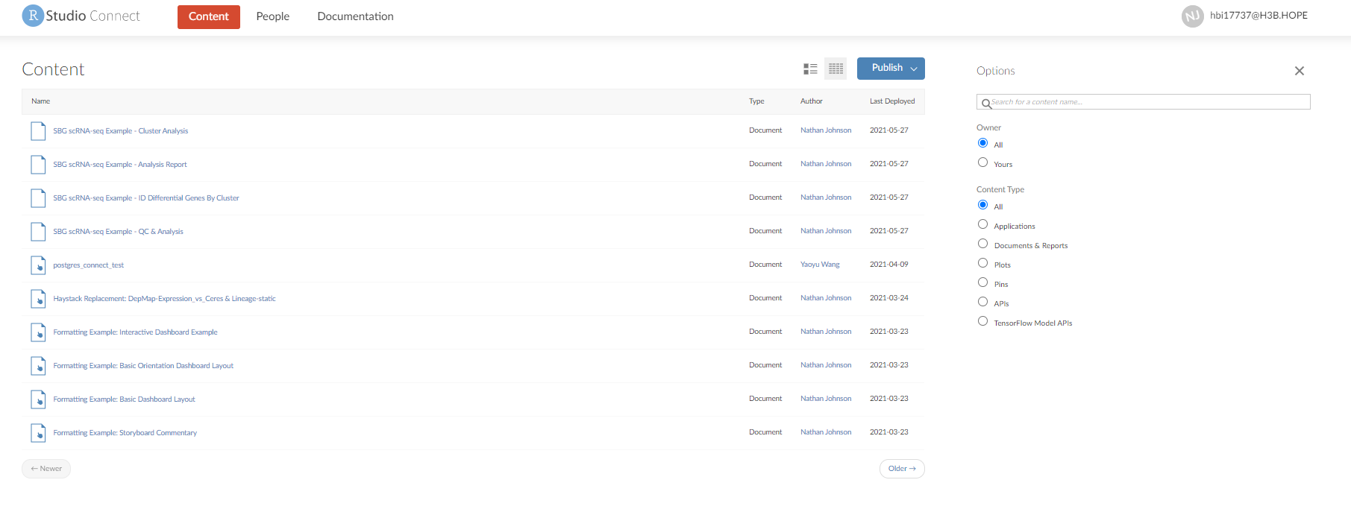
Host Dashboards OR Reports Genomic Infrastructure Improvements (R-Connect)

Slide 25
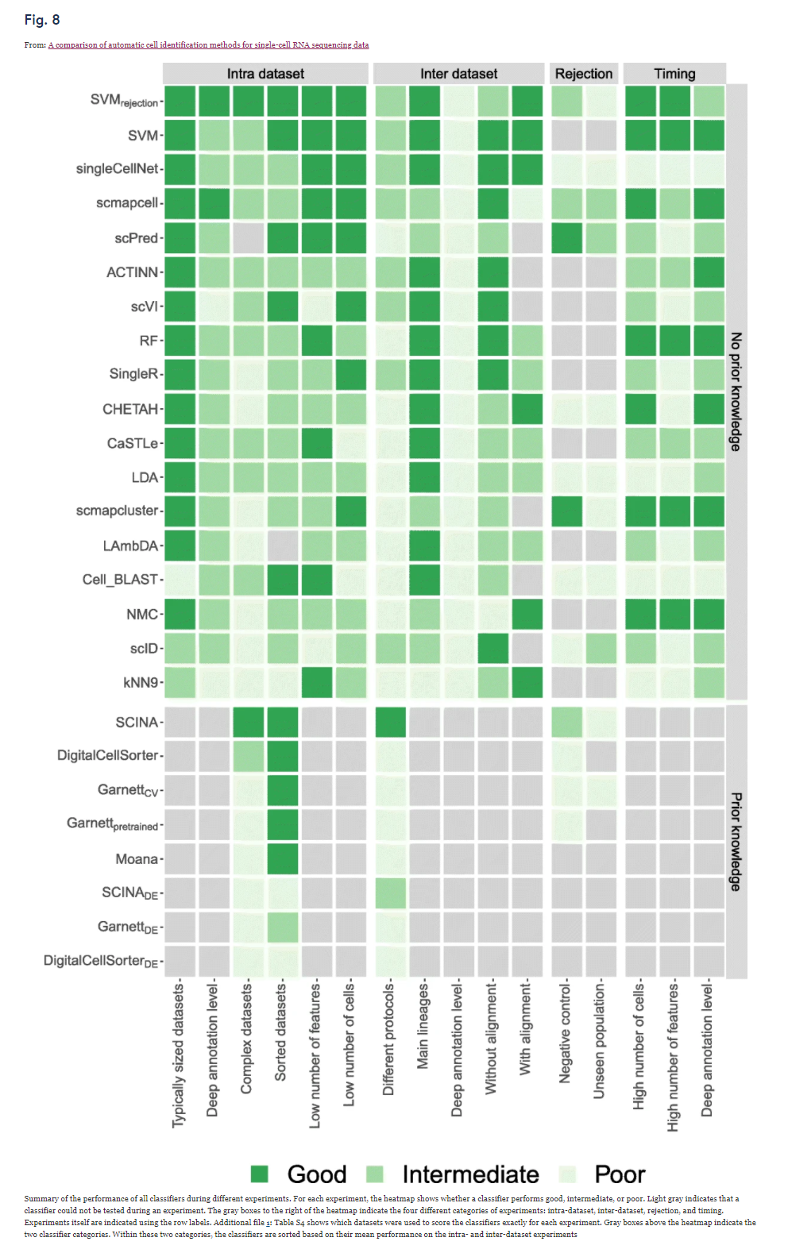
Cell Type Calling (Currently Using at H3)
Cell Type Calling Types
Reference Transcriptomic Datasets
Machine Learning Based Classifiers
Deep Learning Hybrid Methods
*All methods highly dependent on ‘prior-knowledge’ and biological context to evaluate
Currently Using SingleR
Good Balance between Ease of
Use / Accuracy / Computing Resources
Ideally, want to include multiple cell-type calling
De-Novo
Cell State
Different Computational Assumptions
Abdelaal, Tamim, et al. "A comparison of automatic cell identification methods for single-cell RNA sequencing data." Genome biology 20.1 (2019): 1-19.

Slide 26
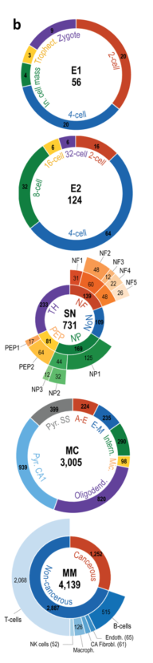
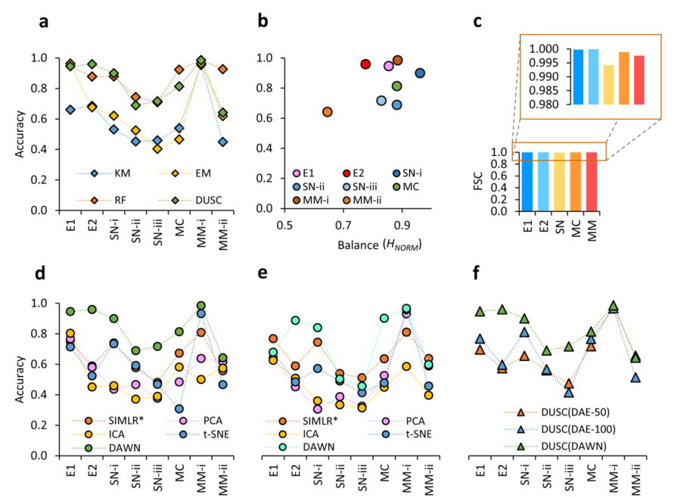
Evaluation Criteria – Hybrid Deep Clustering
Datasets (Cell Hierarchy is each circle)
Evaluation
*Cell Number in center
K-Means
EM
Srinivasan, S., Leshchyk, A., Johnson, N. T., & Korkin, D. (2020). A hybrid deep clustering approach for robust cell type profiling using single-cell RNA-seq data. RNA, 26(10), 1303-1319.

Slide 27
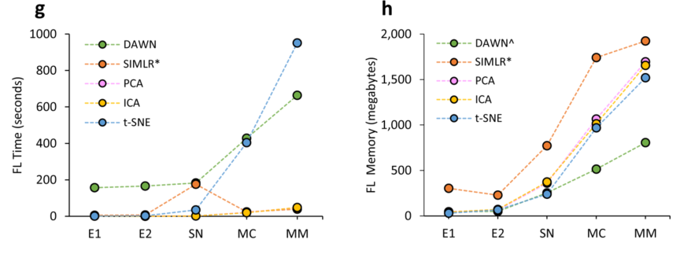
Computational Performance Consideration
Deep Learning Algorithms are typically computationally heavy
Time and Memory consumption for different datasets
Srinivasan, S., Leshchyk, A., Johnson, N. T., & Korkin, D. (2020). A hybrid deep clustering approach for robust cell type profiling using single-cell RNA-seq data. RNA, 26(10), 1303-1319.

Slide 28
Current Final H3 scRNA-Seq Workflow
Raw Sequencing Data
Publicly Available Raw Sequencing Data
SBG Apps
Apps to build
SRA Download and Extract
I/O
Compress Data
Apps Needing Editing
Reformat Files
Prepped Sequencing Data (fastq.gz)
On SBG
On H3 Rstudio-Pro Server
Cell Ranger Count
For Each Cell:
Cell Type
Cell Cycle State
Gene Expression
Dimensionality Reduction Results
Cluster Results
Cluster & Gene Marker Analysis
SingleR Cell Type Calling
Analysis using Seurat Object
*Seurat Object for each sample
**Files can be quite large (~3 Gb)
*** Best to filter and merge for biological question to ask

Slide 29
H3 scRNA-Seq Pilot Project

Slide 30
Study Design
Number of tumors: 13
Groups: Vehicle (3 mice) and HER2-STING (10 mice)
Dose and treatment time: 1 mg/kg IV of 24-hr treatment
Anticipated number of CD45+ cells
Vehicle: 9 million
HER2-STING: 4.3 million
Submit 3 x 0.5 million cells of the vehicle group sample and 3 x 0.5 million cells of the HER2-STING group sample to MIT on ice in the afternoon
Freeze 3 x 1 million cells of the vehicle group sample and 3 x 1 million cells of the HER2-STING group sample in freezing media and ship to BGI.
Team
Yaya Wang
Kun Yu
Xingfeng Bao
Nathan T. Johnson
Yaoyu Wang
Yonghong Xiao
Winnie Tam
Kuan-Chun Huang
Tenghui
*Core Team

Slide 31
Study Workflow
Untreated
24 h
Mice implanted with CT26-HER2 tumors
Harvest tumor
Dissociation of tumor
Treated with HER2-STING ADC
CD45 enrichment
3 days
FACS analysis
Thaw tumor cells
Freeze tumor cells

Slide 32
HER2-STING ADC induces significant tumor cell loss in CT-26/HER2 model
*
*

Slide 33
Thawed CD45+ TILs maintain good viability (>80%) with modest reduction in cell number
1.3 M
0.7 M
CD45+ purity (80.0% for untreated and 92.3% for treated sample)
Cell concentration needs to be 700-1,200 cells/μl prior to run 10x Genomics Single Cell protocols, only need to load 5k to 10k cells

Slide 34
Freeze/thaw process has minimum impact on TIL composition
CD11b+, Ly6G+, Ly6Clow
CD11b+, Ly6G-, Ly6Chigh
CD11b+, F4/80+, Ly6C-, Ly6G-
CD3+, CD8-, CD4+
CD3+, CD8+, CD4-
CD3-, NKp46+

Slide 35
HER2-STING ADC activates immune cells in CT26 tumors
Macrophage
CD8 T cell

Slide 36
scRNA-Seq Analysis Results

Slide 37
Goal & Datasets
First pass analysis to assess the quality & Cell type Calling of Pilot scRNA-Seq Data
3 Datasets
10k PMBC (Comparison)
BGI
MIT

Slide 38
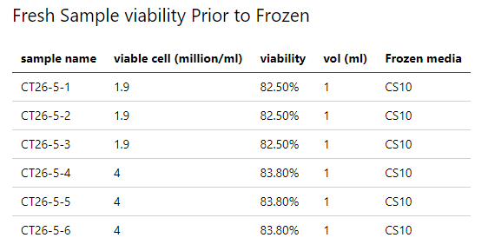
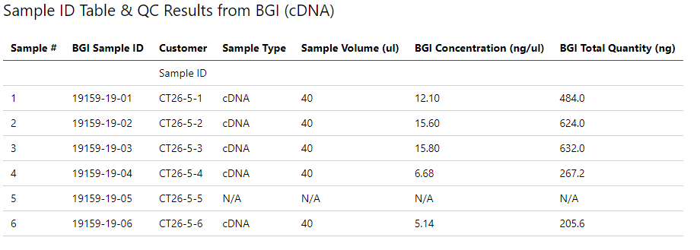
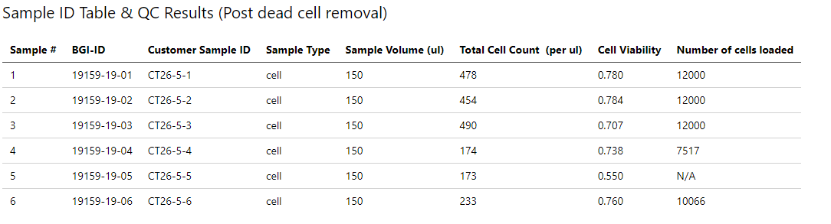
Sample Quality Control
Fresh Sample
had consistent viability
Sample 1-3: 1.9 million
Sample 4-6: 4 million
Library Preparation & QC
Quality and Cell Loading different between 1-3 vs 4-6
Cell Viability, inconsistent despite the consistent viability

Slide 39
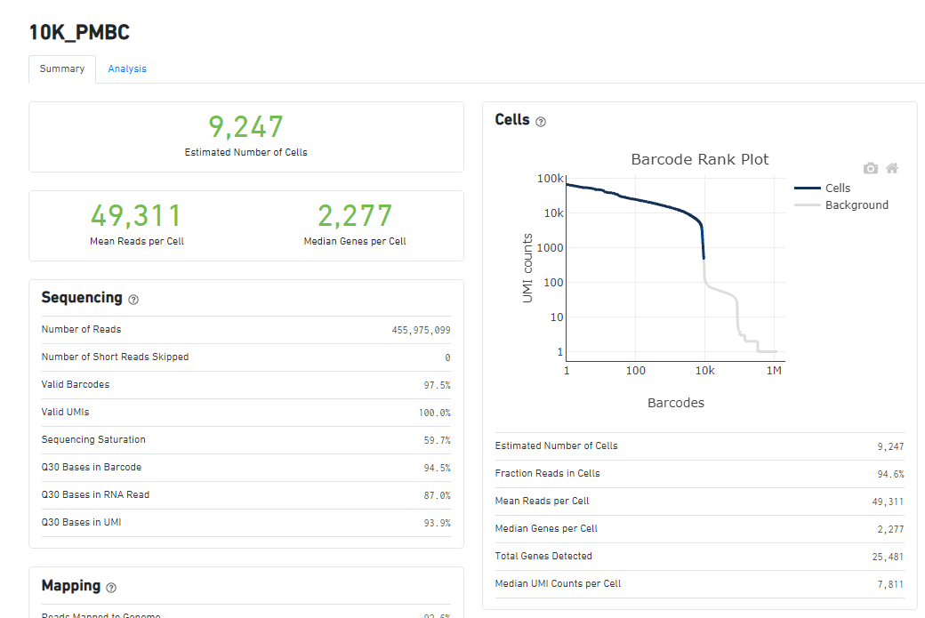
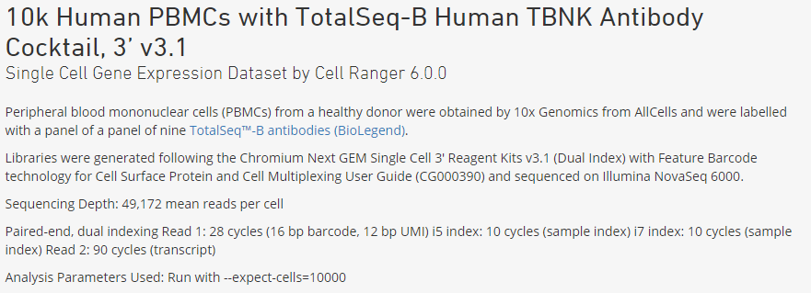
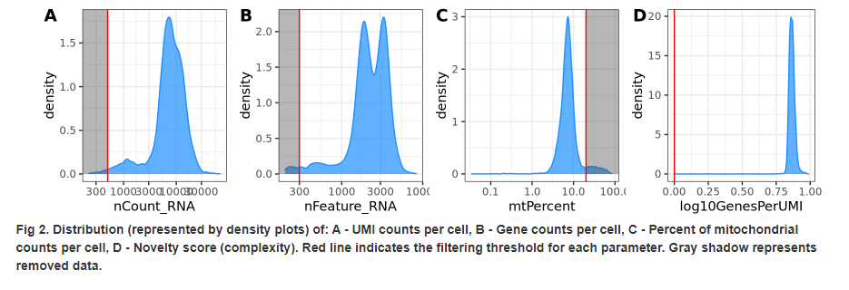
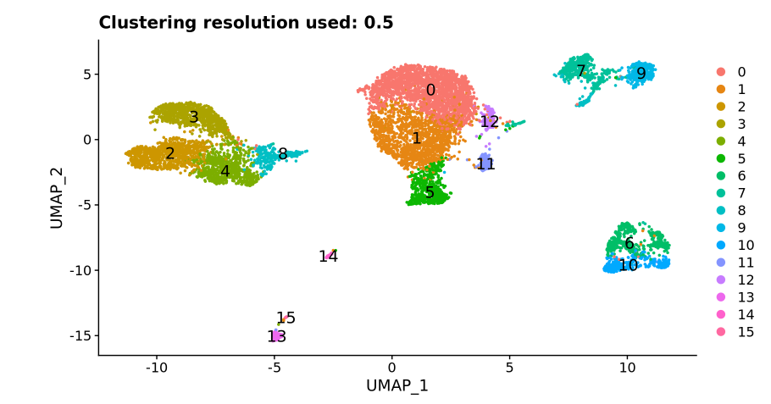
10k PMBC Results (Easy Biology & Example of clean scRNA-Seq)

Slide 40
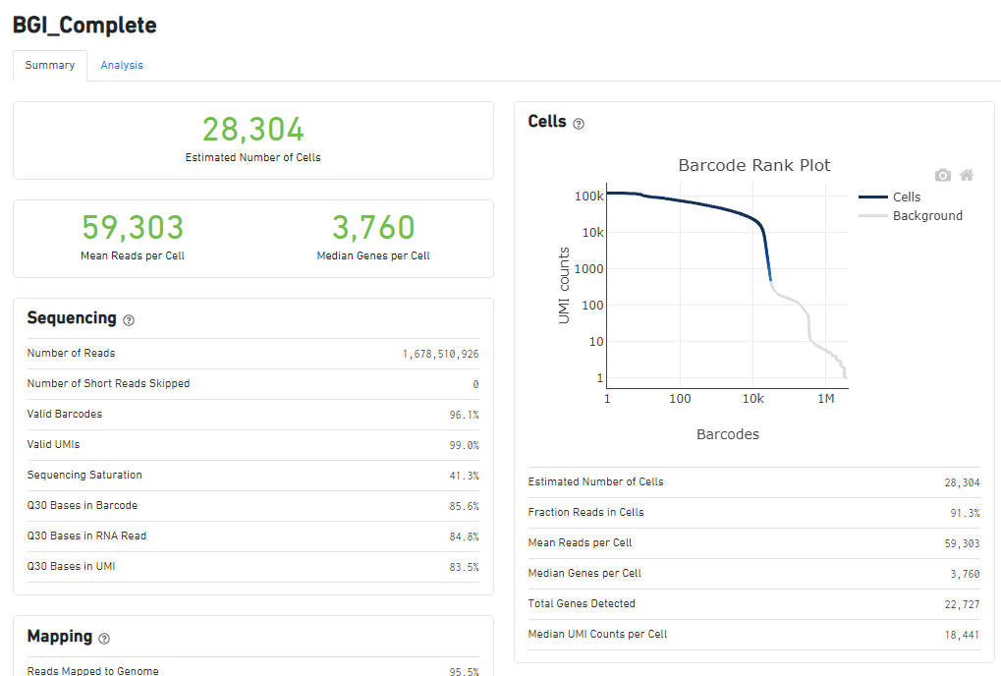
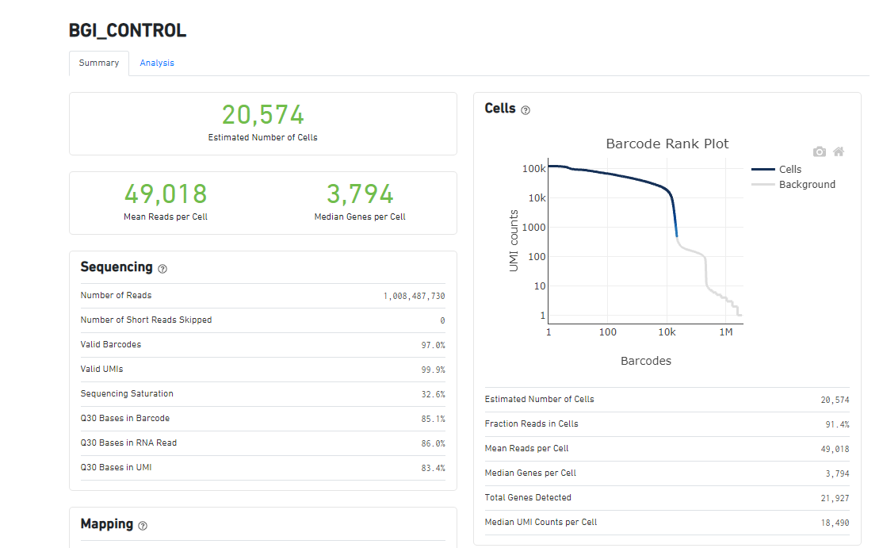
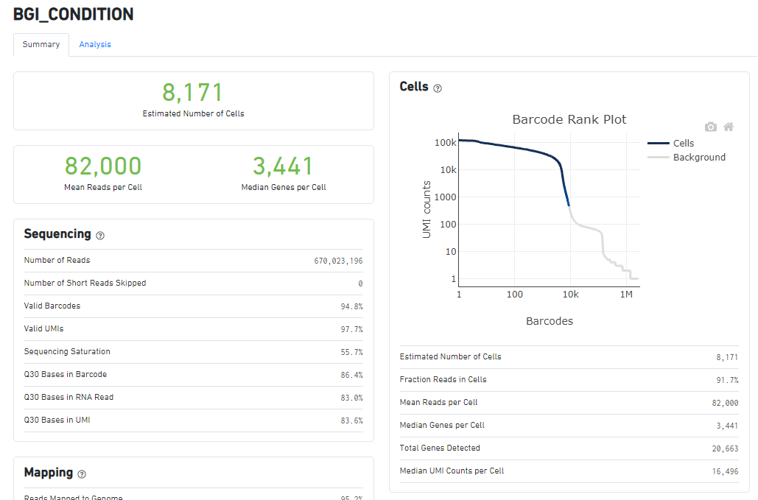
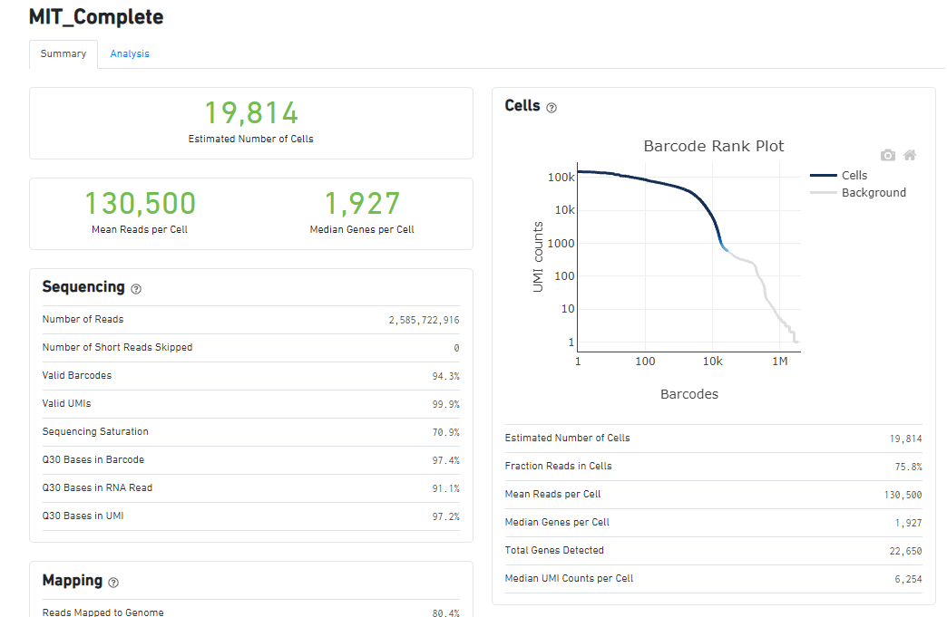
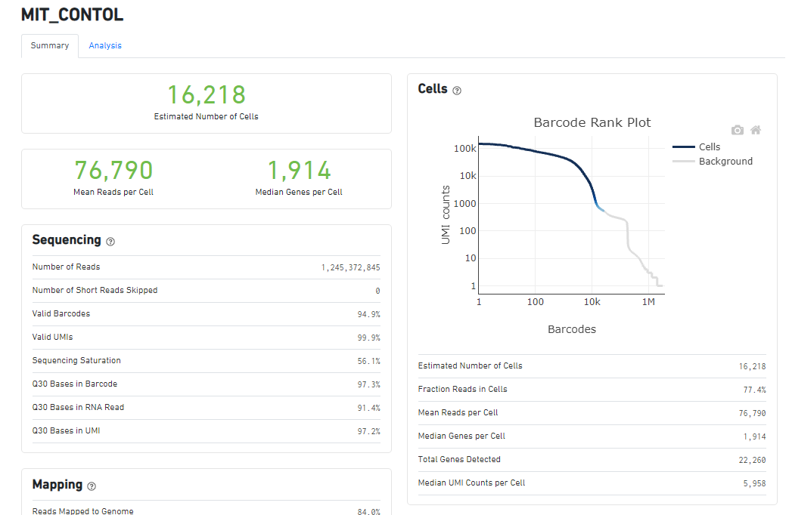
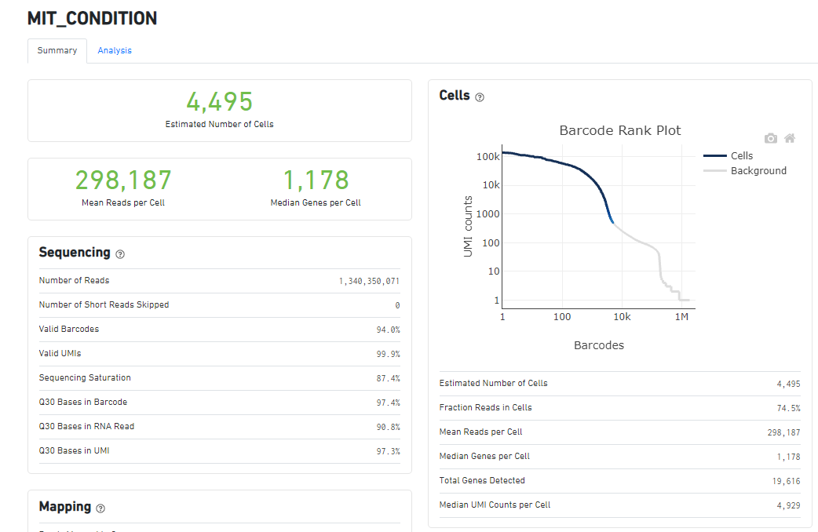
Overall Statistics

Slide 41
Basic MIT and BGI Quality Control Measure compare to 10K PBMC
 | Estimated # of Cells | Mean Reads Per Cell | Median Genes per Cell | Sequencing Saturation | Reads Mapped to Intergenic Regions | Mapped to Transcriptome
10X | 9,247 | 49,311 | 2,277 | 59.70% | NA | NA
BGI
Control | 20,574 | 49,018 | 3,794 | 32.60% | 3.10% | 73.80%
Condition | 8,171 | 82,000 | 3,441 | 55.70% | 3.60% | 71.20%
MIT
Control | 16,218 | 76,790 | 1,914 | 56.10% | 8.40% | 52.40%
Condition | 4,495 | 298,187 | 1,178 | 87.40% | 15.40% | 43.50%

Slide 42
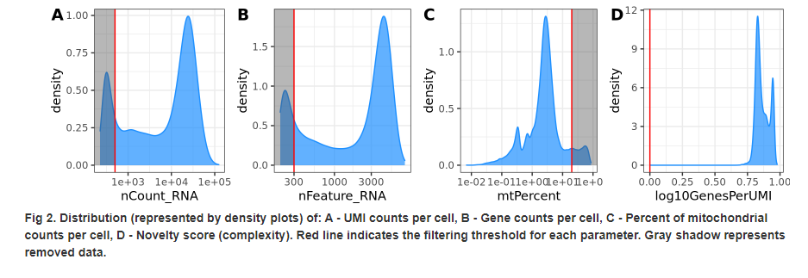
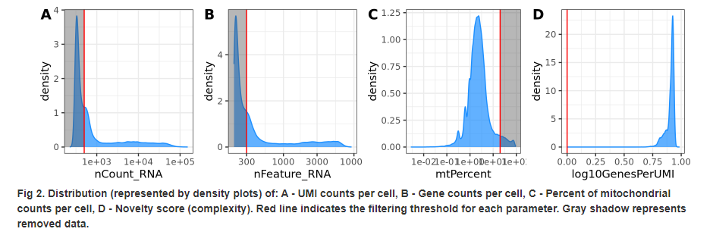
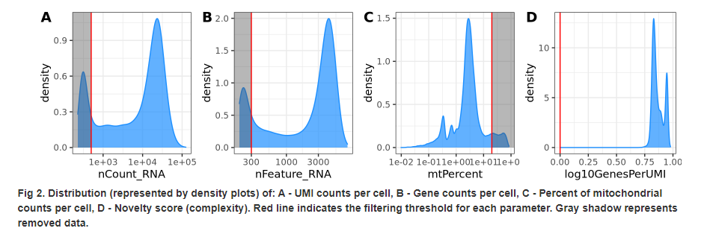
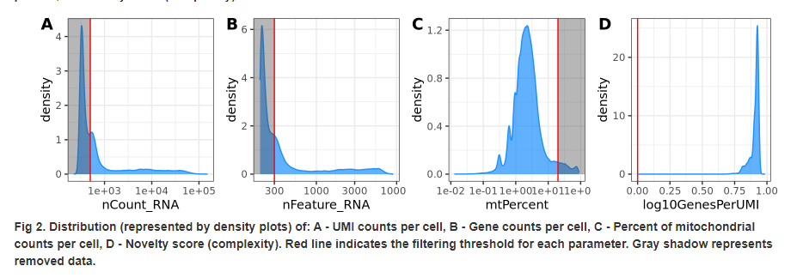
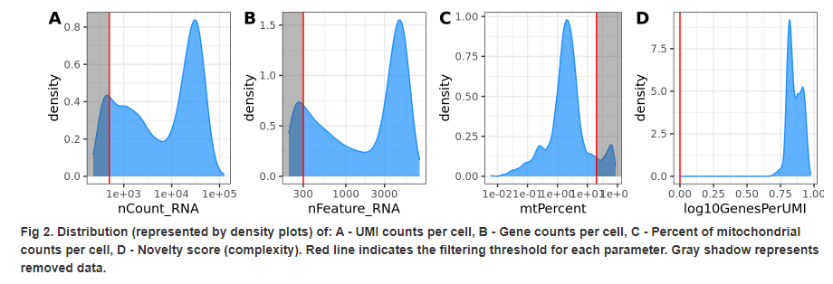
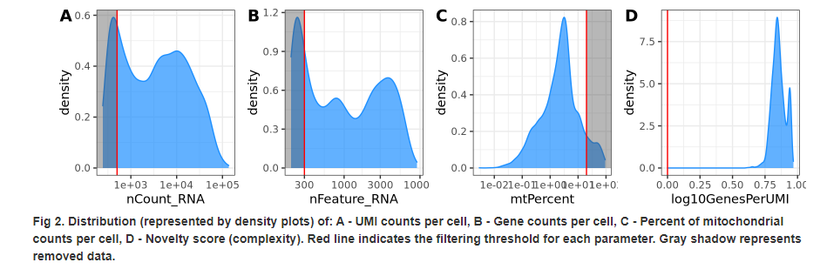
Distribution & Sampling Depth
BGI
MIT
Complete
Control
Condition

Slide 43
Distribution & Sampling Depth (Compared to ‘easy’ dataset)
10k PMBC Control Dataset
BGI
MIT
Control
Condition

Slide 44
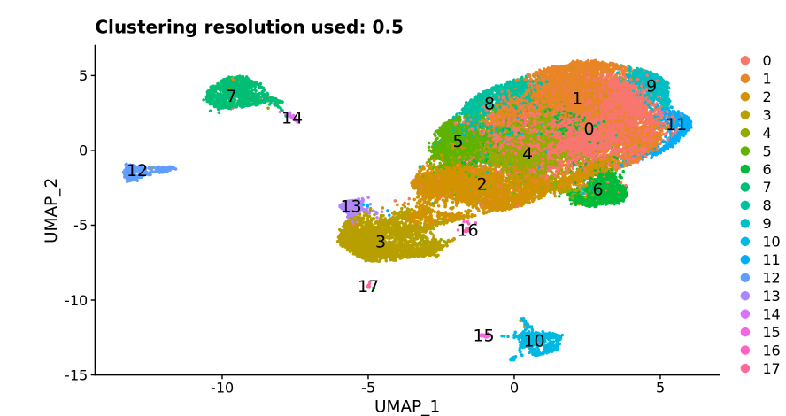
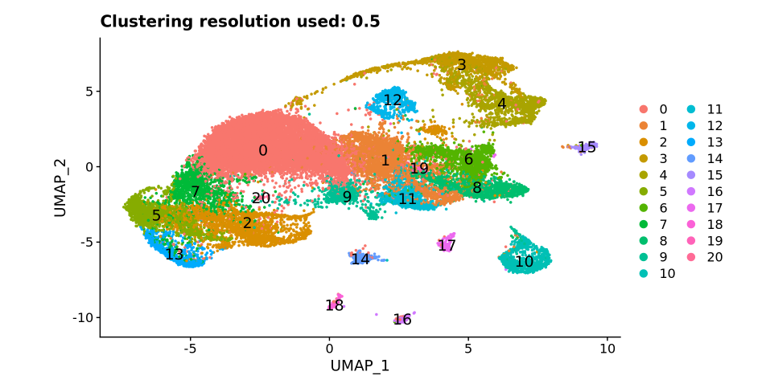
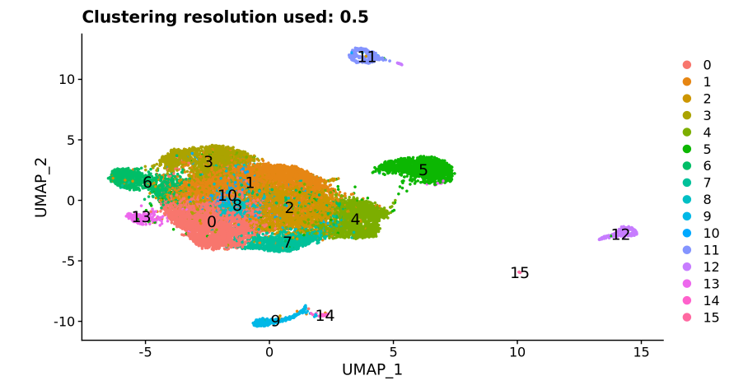
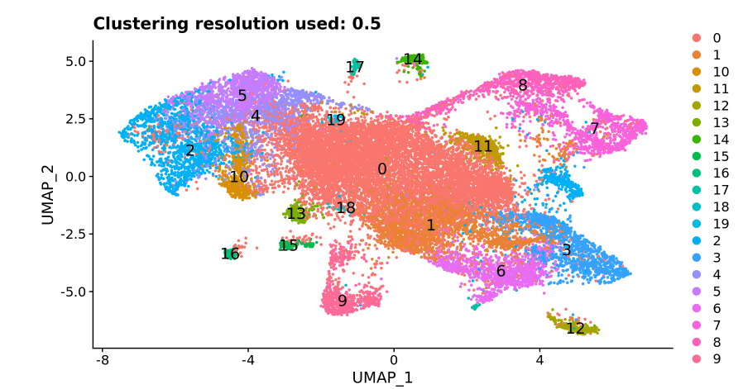
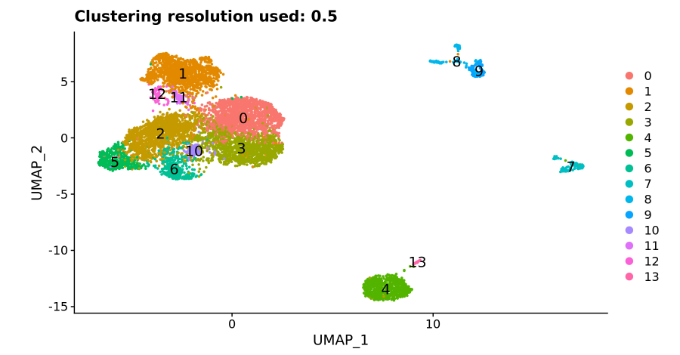
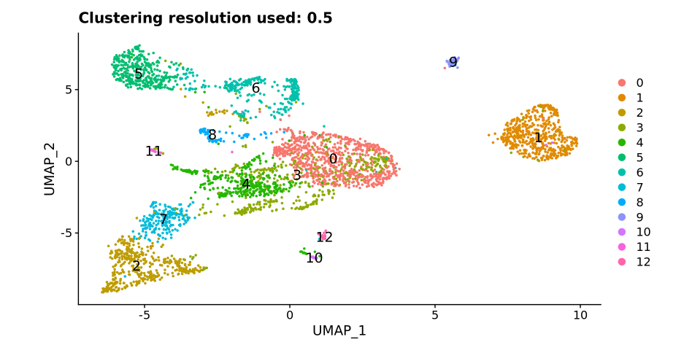
Overall Pattern
MIT
BGI
Complete
Control
Condition

Slide 45
Cell Type By Sample Percentage

Slide 46
BGI Percentage Pie Charts
Control
Condition

Slide 47
MIT Percentage Pie Charts
Control
Condition

Slide 48
A lot of Noise on Plot

Slide 49
Removing Fibroplasts and Epithelial Does Not Change

Slide 50
Lower Complexity

Slide 51
Conclusions & Next Steps
Next Steps
Current, pilot study conclusion
H3 scRNA-Seq wet-lab and sequencing workflow needs improvement
To Validate Conclusion isn’t Analysis Pipeline Dependent
Biologists selected publicly available datasets that have similarity to the biology of the pilot study
Currently Processing Publicly Available Datasets with workflow
*Major bug in SBG current workflow which relabels the fastq files causing paired end reads not to match
Solution: Copy to H3 S3 Bucket using SBG CLI API pipeline -> Reprocess fastq file -> Copy Back to SBG Platform -> Proceed with pipeline
Goal: Be able to prove analysis pipeline gets similar results as published findings

Slide 52
Backup

Slide 53
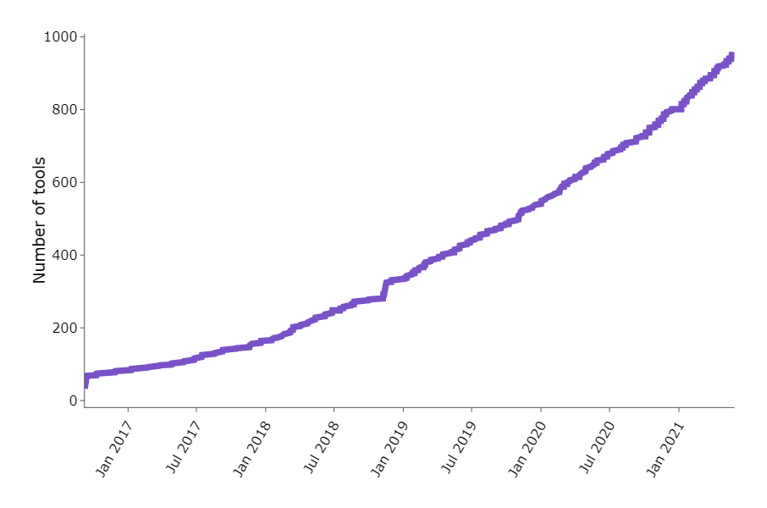
Number of New scRNA-Seq Tools
Zappia L, Phipson B, Oshlack A. "Exploring the single-cell RNA-seq analysis landscape with the scRNA-tools database", PLOS Computational Biology (2018), DOI: 10.1371/journal.pcbi.1006245

Slide 54
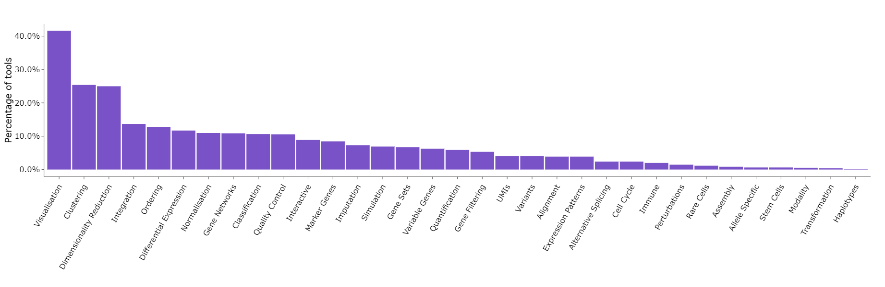
Categories of tools (June 2021)
Zappia L, Phipson B, Oshlack A. "Exploring the single-cell RNA-seq analysis landscape with the scRNA-tools database", PLOS Computational Biology (2018), DOI: 10.1371/journal.pcbi.1006245

Slide 55
Conclusion
For untreated condition, 1 or 2 tumors (~ 100 mm³) would be sufficient for scRNA-seq study.
For treated condition, 3 or less tumors (~ 100 mm³) would be sufficient for scRNA-seq study.
Thawed CD45+ TILs have good viability (>80%), which meets the standards of 10x Genomics Single Cell protocol.
Freeze/thaw process has minimum impact on immune cell composition in the tumor.

Slide 56
Discussion
Treatment time
Shall we include additional time points?
Number of mice
Shall we pool animals for untreated condition (biological replicates)?

Slide 57

Gating strategy for myeloid panel

Slide 59

Distribution of UMI, Gene Counts, Mitochondrial

Slide 60

UMAP of Data

Slide 61



Slide 62



Slide 63


Cell Ranger Basic Metrics

Slide 64

How to draw biologically meaningful insights from scRNASEQ
Identifying cell types or cell states of interest
Visualization of dimensionality reduction : PCA, tSNE, UMAP
Clustering : kmeans , graph-based, hierarchical
Marker gene detection: DEG analysis between clusters and doing pathway analysis
Trajectory inference: ordering cells along a pseudotime trajectory where pseudotime is calculated based on expression similarities of neighboring cells

Slide 65

scRNA-Seq Basic Quality Control
Luecken, Malte D., and Fabian J. Theis. "Current best practices in single‐cell RNA‐seq analysis: a tutorial." Molecular systems biology 15.6 (2019): e8746.

Slide 66

scRNA-Seq Cluster Analysis
Luecken, Malte D., and Fabian J. Theis. "Current best practices in single‐cell RNA‐seq analysis: a tutorial." Molecular systems biology 15.6 (2019): e8746.

Slide 67



POSTN seems to be expressed on CAFs and endothelial cells
Lung Adeno Singlecell RNASEQ
Melanoma Tumor Singlecell RNASEQ
doi: 10.1126/science.aad0501
NSCLC Lung Atlas – (Lambrechts lab)

Slide 68

scRNA-Seq Identify Genes between clusters
Luecken, Malte D., and Fabian J. Theis. "Current best practices in single‐cell RNA‐seq analysis: a tutorial." Molecular systems biology 15.6 (2019): e8746.

Slide 69

scRNA-Seq Cell State Comparison
Luecken, Malte D., and Fabian J. Theis. "Current best practices in single‐cell RNA‐seq analysis: a tutorial." Molecular systems biology 15.6 (2019): e8746.

